Slide 1
CSI2P(I) 2019 Spring
Final Exercise

Slide 2
12145 - Species of Knuckles

Slide 3
Problem
Sample Input:
5
abcca
Sample Output:
I'm the god of Knuckles!
aab -> bbb
aabcc -> bbbcc -> bbbbb
If any character appears above twice, the answer is YES !

Slide 4
Hint
Problem has memory limitation
Declare one 26-dimension array representing characters’ frequency
‘a’ ~ ‘z’
After processing input, count each element of array and output answer

Slide 5
12146 - Too Many Things to Buy

Slide 6
Problem
Input:
n : how many items
k : must buy at least k item at first day
Item’s prices at first day
Item’s prices at second day
Output:
Miuimum price

Slide 7
Problem
Sample Input:
5 2
6 8 9 5 4
5 1 10 3 2
Sample Output:
21
In the end, you still have to buy all items
At first day, you have to buy k items that is cheaper than ones at second day in order to save money
We have to sort items according to its relative prices between two days -> Buy first k cheaper items at first day
First day | 6 | 8 | 9 | 5 | 4
Second day | 5 | 1 | 10 | 3 | 2
Relative price | -1 | -7 | 1 | -2 | -2

Slide 8
12152 - youbike racer

Slide 9
12152 - youbike racer
Input:
6 5 ---> 6 checkpoint, able to pass through 5 units
2 4 7 8 9 14 ---> Location of each checkpoint
|---|---|---|---|---|---|---|---|---|---|---|---|---|---|---|
A
Output:
2

Slide 10
12152 - youbike racer
|---|---|---|---|---|---|---|---|---|---|---|---|---|---|---|
A 2 4 7 9 14
A is able to pass checkpoint 4, however, it is impossible to reach checkpoint 7.
5 > 2, no need to stop to change to a new bike
5 > 4, same reason as above
5 < 7, cannot reach 7
We have to change bike at the previous checkpoint, i.e., checkpoint 4
Now, the bike have the ability to ride (4 + 5) units.
9 < 9, no need to change
9 < 14, we cannot reach 14 unless the bike is a new one
Change the bike at its previous checkpoint, i.e., checkpoint 9
9 + 5 = 14, we’re good to go.

Slide 11
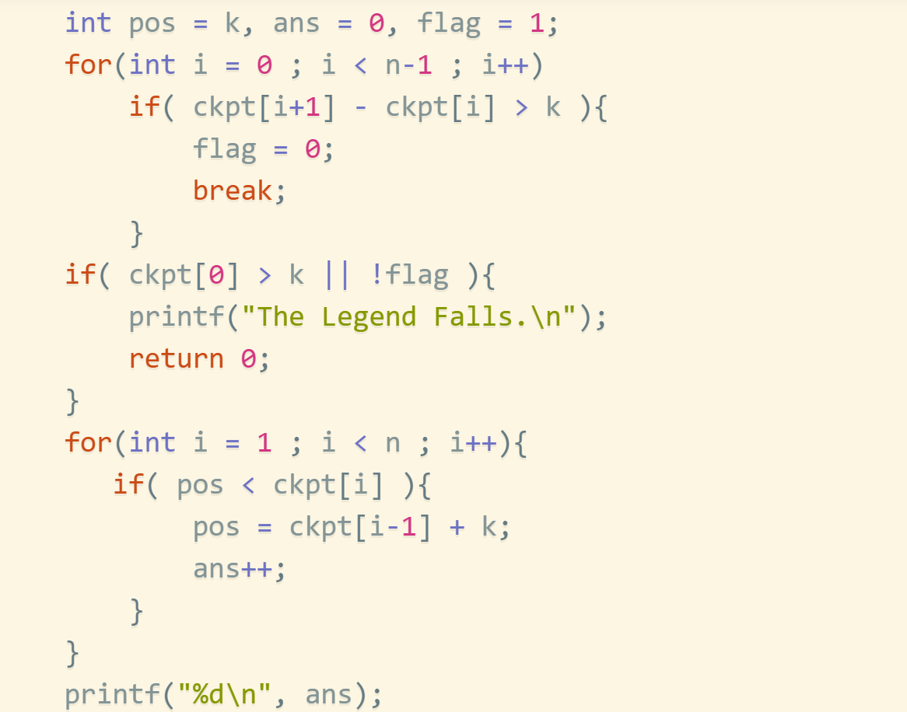
12152 - youbike racer

Slide 12
12289 - after rain

Slide 13
12289 - after rain
Functions:
insert <color> <dest> : insert Black 13 ---> insert Black after the 13-th location
erase1 <dest> : erase1 4 ---> erase the 4-th in the sequence
erase2 <color> : erase2 White ---> erase all white in the sequence
reverse <dest1> <dest2> ---> {‘A’, ‘B’, ‘C’} -> {‘C’, ‘B’, 'A'}
show ---> a simple show function

Slide 14
12289 - after rain
Focus on the limitation on each functions.
For example,
“erase1 n”, what if n is larger than the length of the sequence?
……
See 12289 for more details.

Slide 15
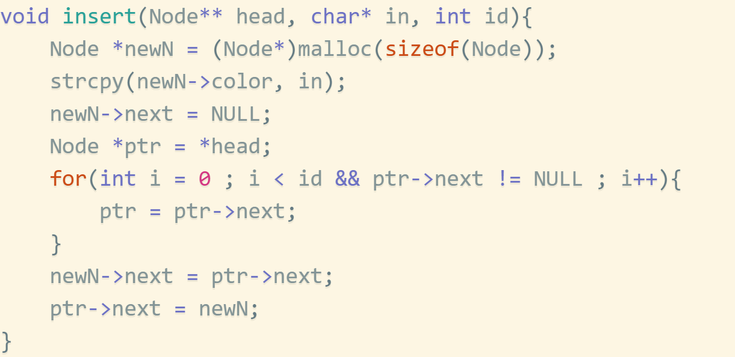
Insert
Data Structure: Linked list, Method: insert

Slide 16
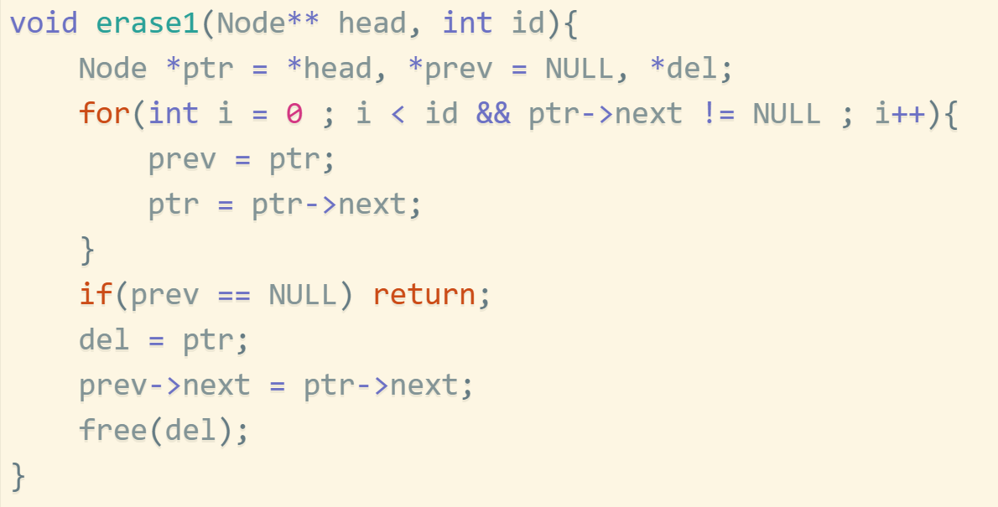
Erase1
Method: remove

Slide 17
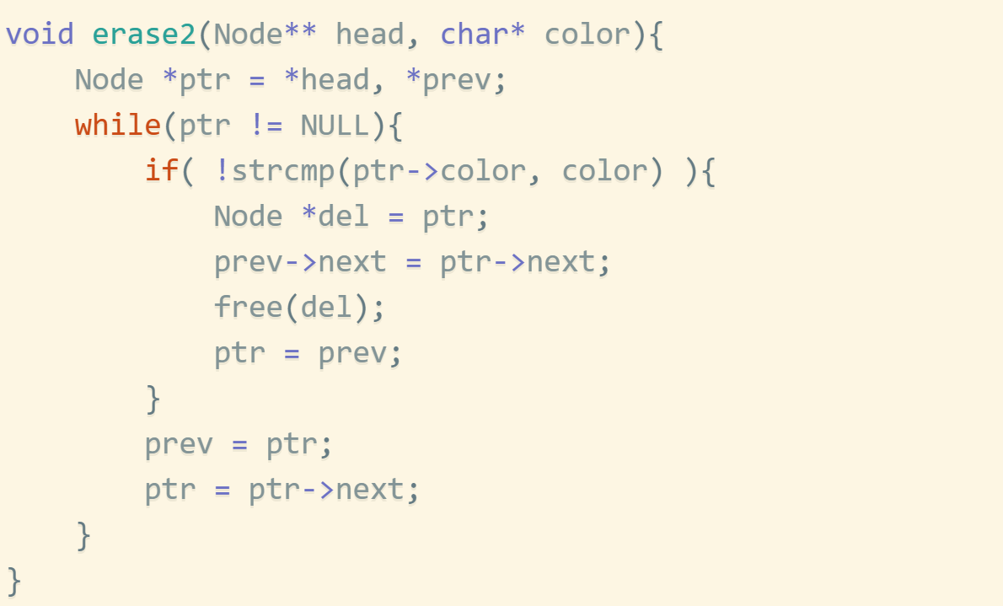
Erase2

Slide 18
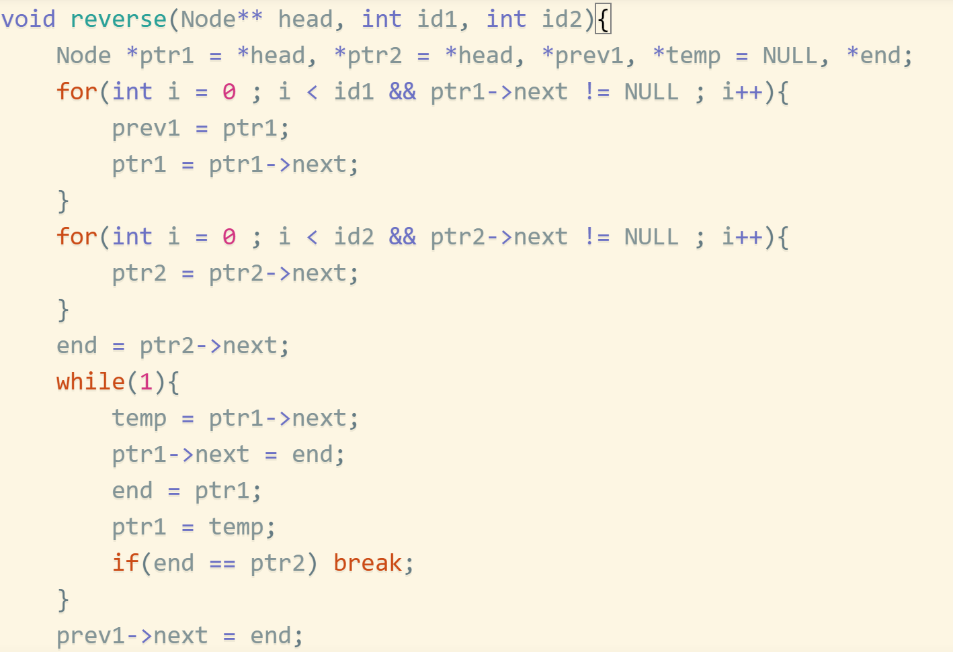
Reverse

Slide 19
12301 - Uncle Huang choose Tutor (Easy version)

Slide 20
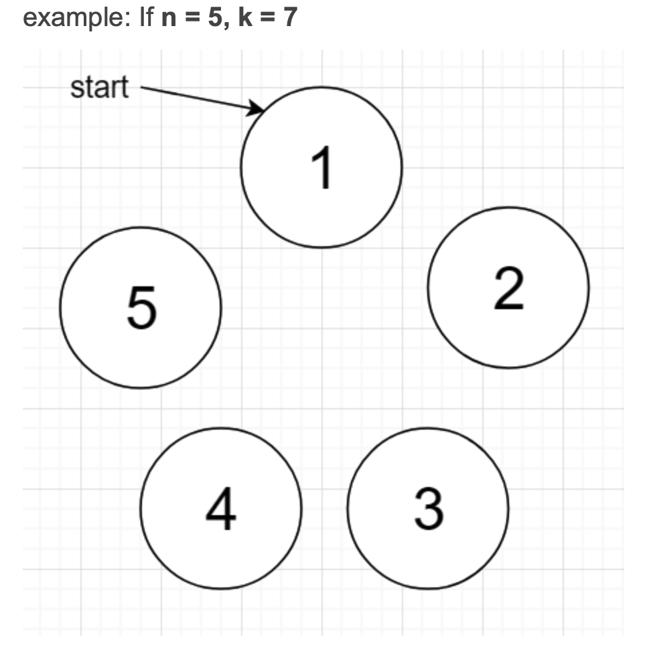
Joseph problem
Given number of people and the steps you go to kill people

Slide 21
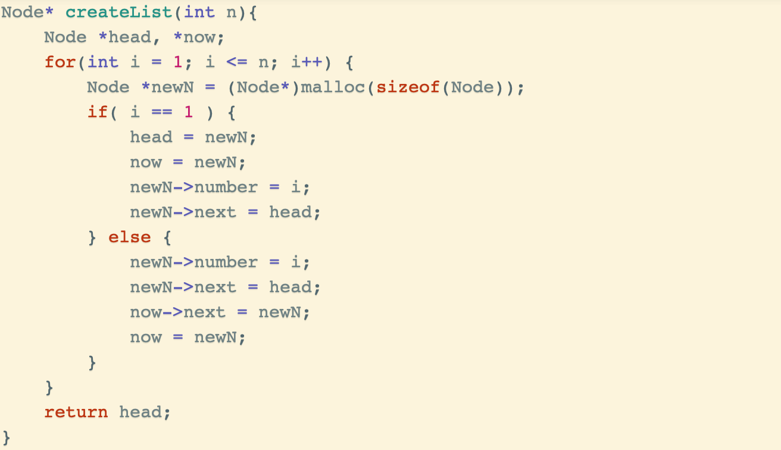
Joseph problem
Using link list

Slide 22
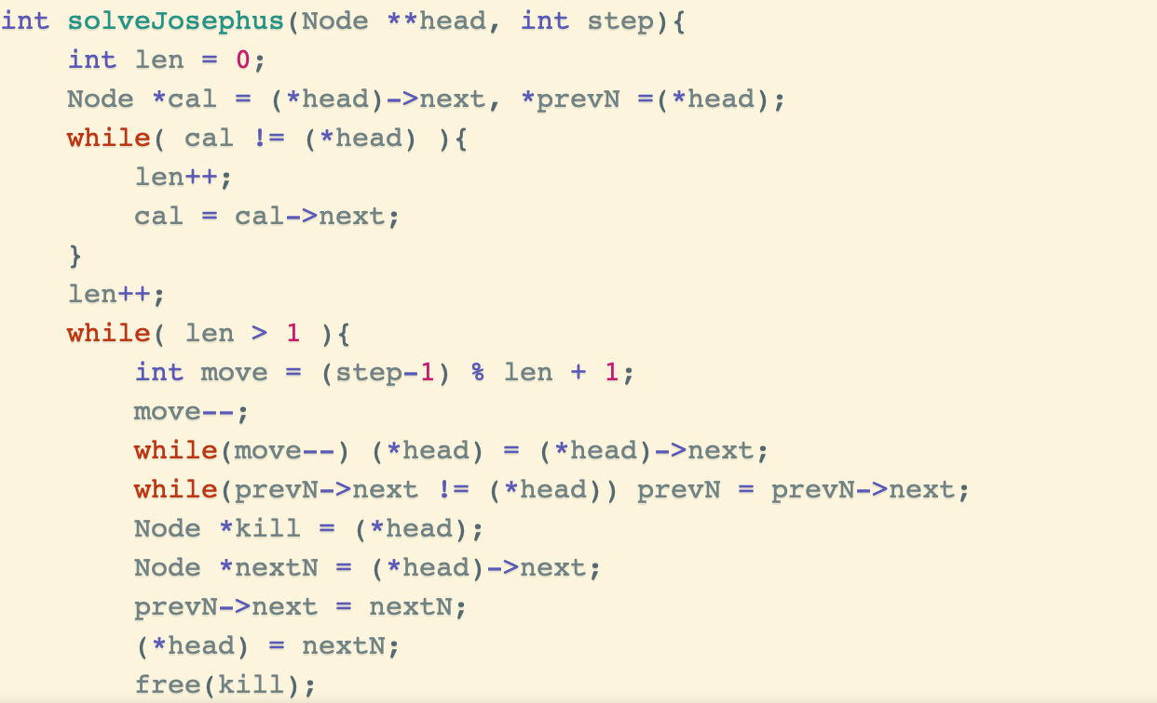
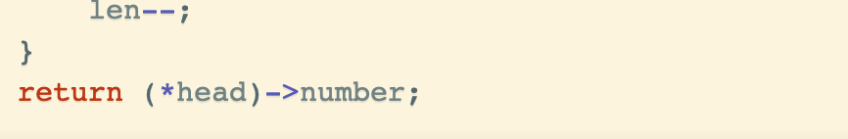
Joseph problem
Using link list

Slide 23
12301 - Uncle Huang choose Tutor (Hard version)

Slide 24
Joseph problem
Given number of people and the steps you go to kill people

Slide 25
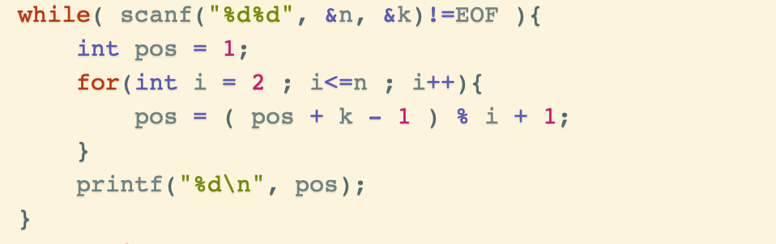
Joseph problem
Using DP

Slide 26
Joseph problem
Using DP
We suppose that we have n people and m steps
Initially, we have people 0~n-1(f(n,m))
After the first round, the kth people be killed(k = (m - 1) % n)
When the second round begin, k+1 = 0(f(n-1,k))
k+1 = 0 , k+2 =1 …n-1= n-k-2, 0 = n-k-1 , …… k-1 = n-2
f(n,m) = (f(n-1 , m) + k + 1)%n
f(n,m) = (f(n-1 , m) + m )%n

Slide 27
Joseph problem
Using DP
f(n,m) = (f(n-1 , m) + m )%n

Slide 28
12303 - Operation on Sequence

Slide 29
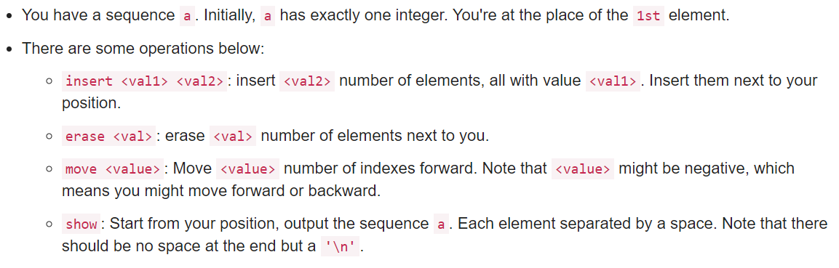
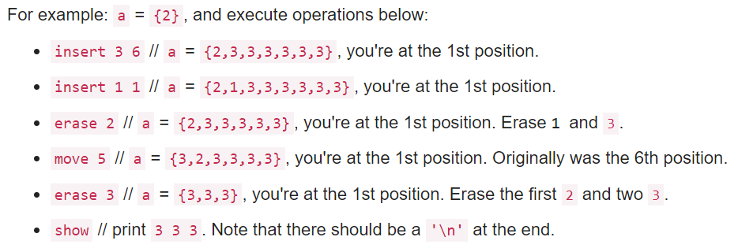

Slide 30
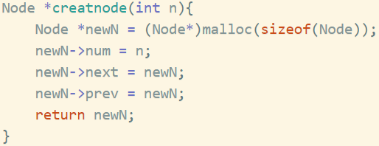
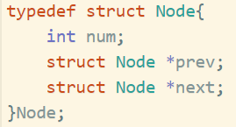
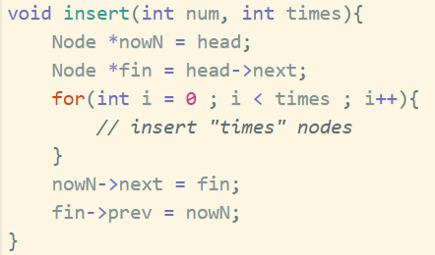
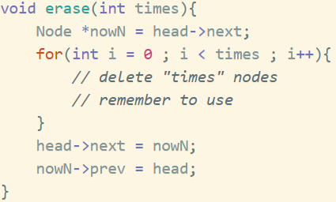
Using Linked List

Slide 31
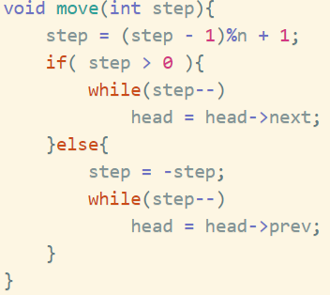
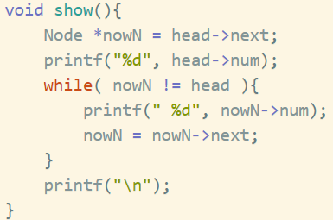
Using Linked List

Slide 32
12305 - Airplane Shooter

Slide 33
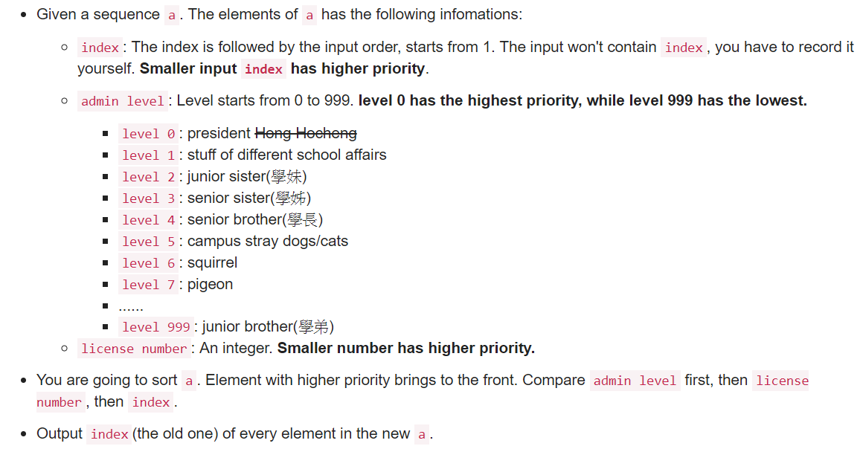
Easy qsort problem without any other tricks ……

